Slide 1
~ Roots of Equations ~ Open Methods Chapter 6
Credit: Prof. Lale Yurttas, Chemical Eng., Texas A&M University

Slide 2
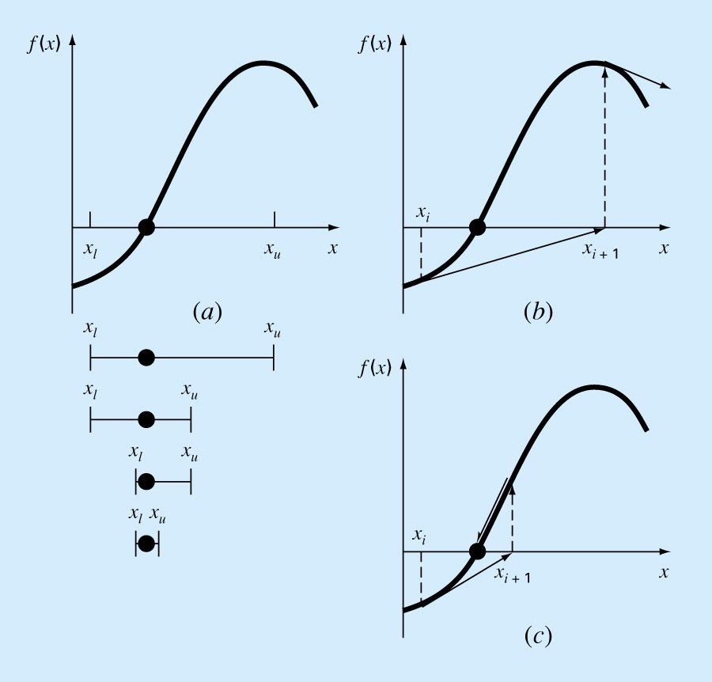
Open Methods
Generally use a single starting value or two starting values that do not need to bracket the root.
Open Method (convergent)
(divergent)

Slide 3
Simple Fixed-point Iteration
Rearrange the function so that x is on the left-hand side of the equation:
EXAMPLE:
Bracketing methods are “convergent” if you have a bracket to start with
Fixed-point methods may sometimes “converge”, depending on the starting point (initial guess) and how the function behaves.

Slide 4
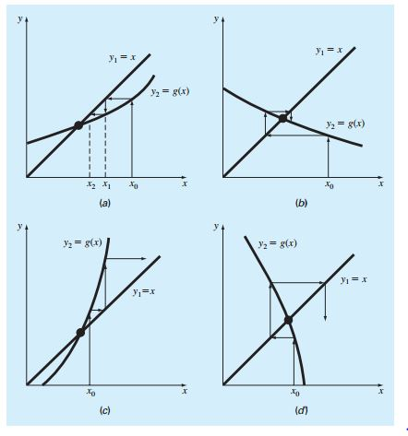

Slide 5
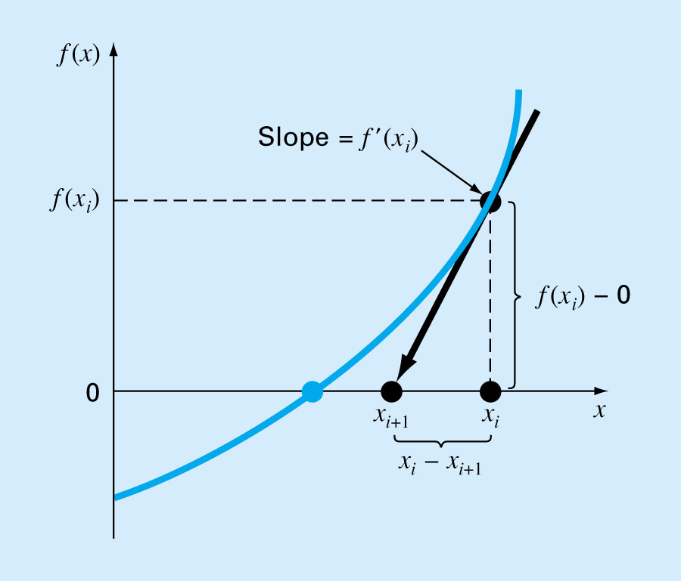
Newton-Raphson Method
Most widely used formula for locating roots.
Can be derived using Taylor series or the geometric interpretation of the slope in the figure

Slide 6
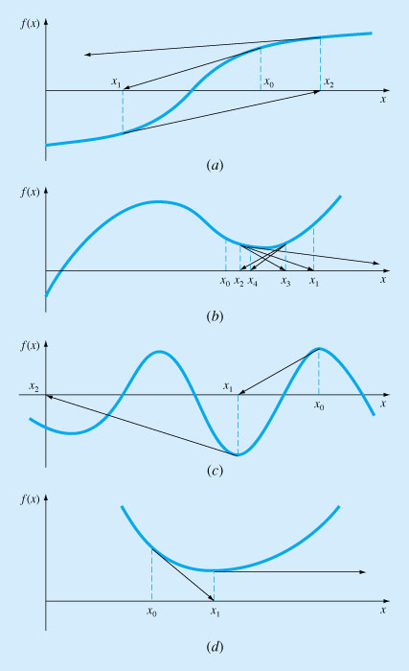
Newton-Raphson is a convenient method if f’(x) (the derivative) can be evaluated analytically
Rate of convergence is quadratic, i.e. the error is roughly proportional to the square of the previous error
E_{i+1}=O(E_{i}²)
(proof is given in the Text)
But:
it does not always converge ➔➔➔
There is no convergence criterion
Sometimes, it may converge very very slowly (see next slide)

Slide 7
Example : Slow Convergence
Iteration | x
0 | 0.5
1 | 51.65
2 | 46.485
3 | 41.8365
4 | 37.65285
5 | 33.887565
.
.
38 | 1.083
∞ | 1.0000000

Slide 8
The Secant Method
If derivative f’(x) can not be computed analytically then we need to compute it numerically (backward finite divided difference method)
RESULT: N-R ➔becomes➔ SECANT METHOD

Slide 9
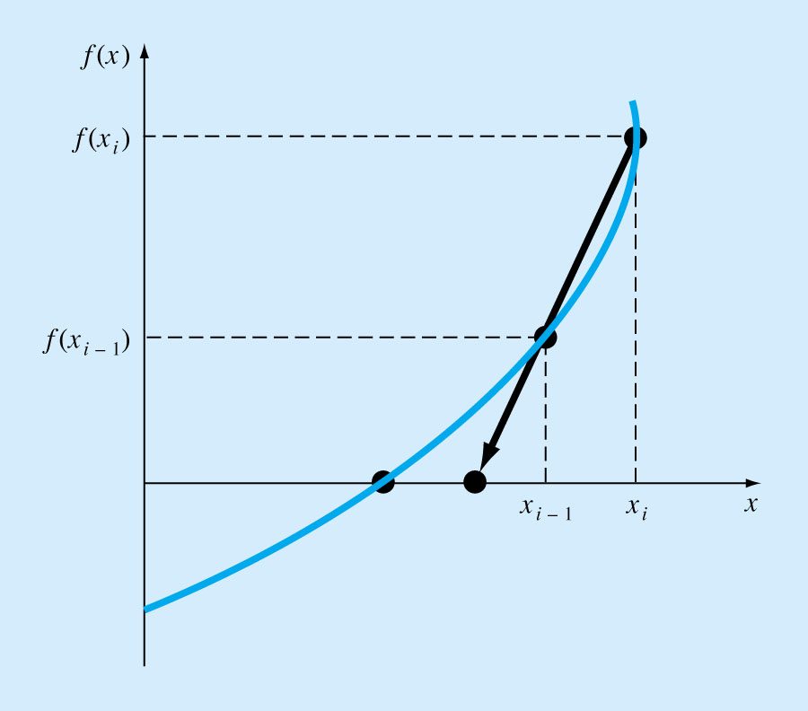
The Secant Method
Requires two initial estimates x_{o}, x₁.
However, it is not a “bracketing” method.
The Secant Method has the same properties as Newton’s method.
Convergence is not guaranteed for all x_{o}, f(x).

Slide 10
Modified Secant Method

